Slide 1
Pervasive Gym
Johan Arleth
Nikolaos Grigoriadis
Mugisha Maurice

Slide 2
Problem
Motivation
Expensive fitness trainer
Track progress
Posture, doing exercises wrong etc.

Slide 3
The Setup

Slide 4
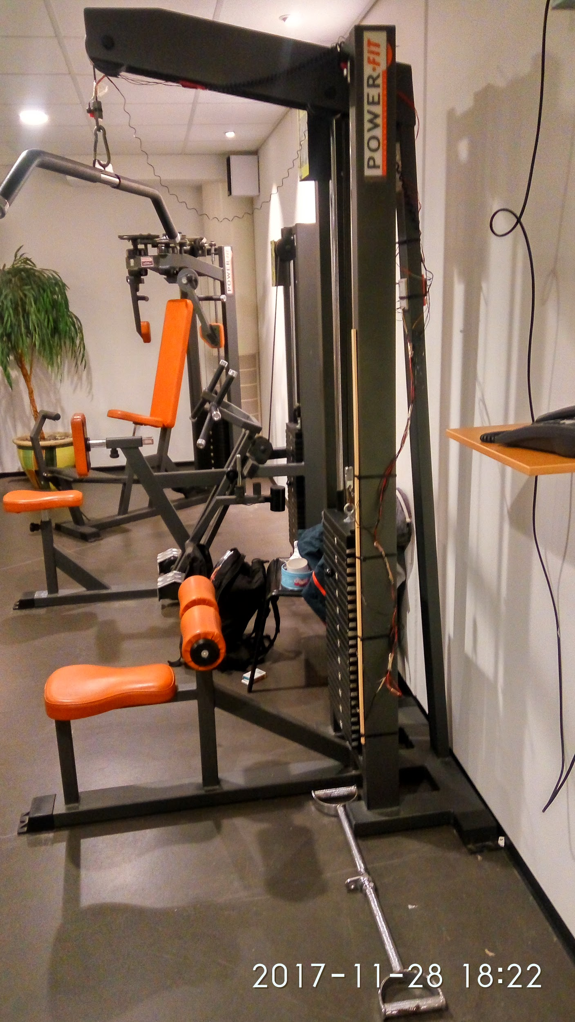
The Setup (1/5): The main machine
6 Degrees of Freedom
Parallax Ping Ultrasonic
TCRT 5000 IR

Slide 5
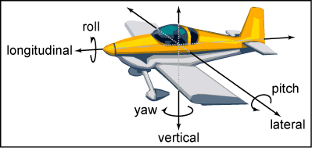
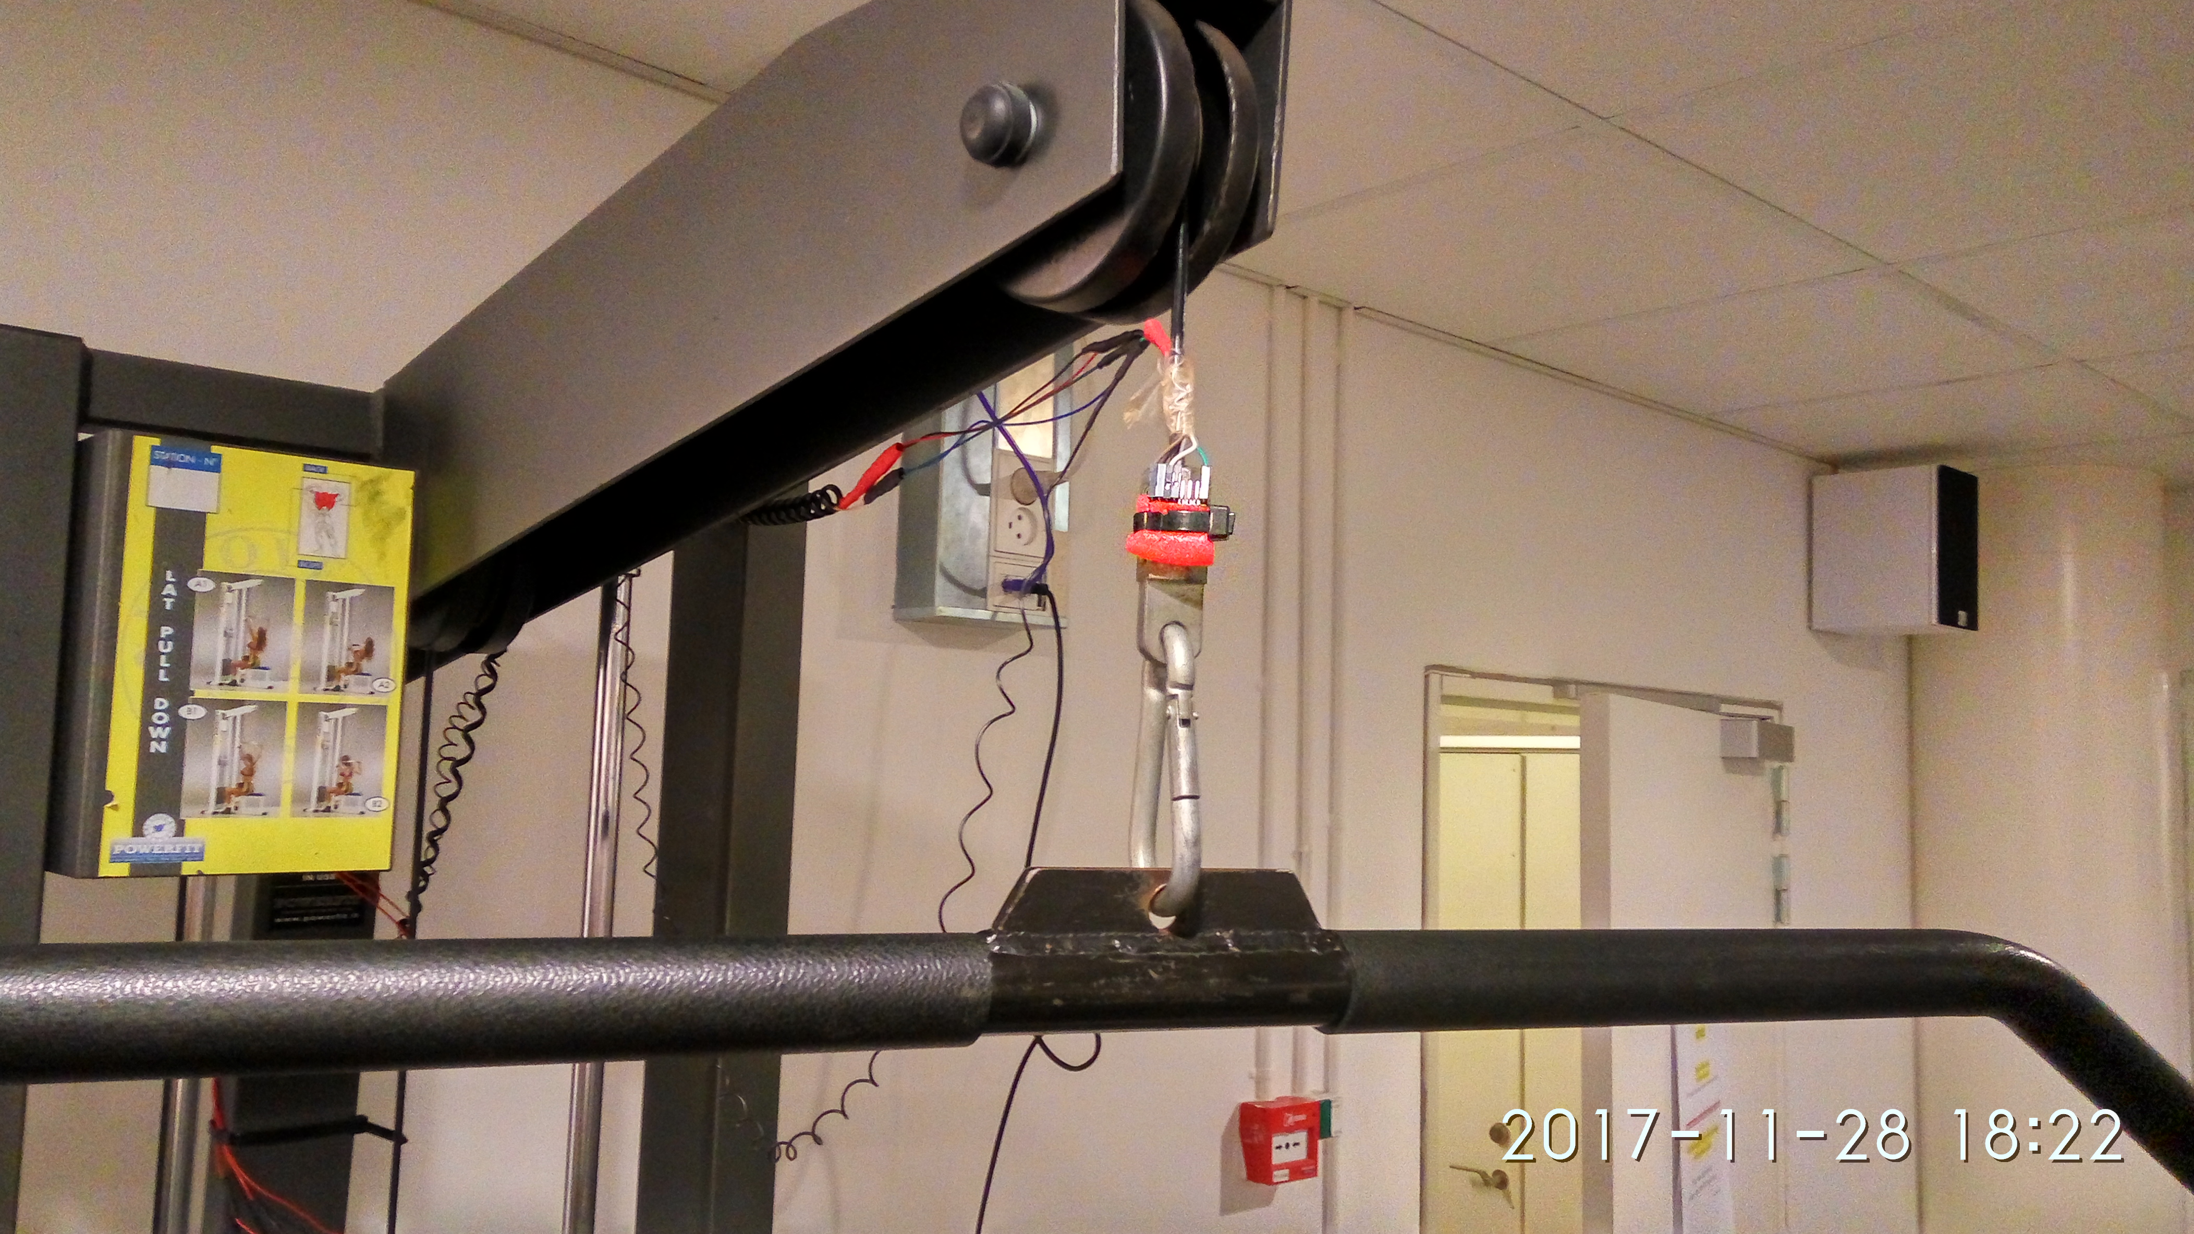
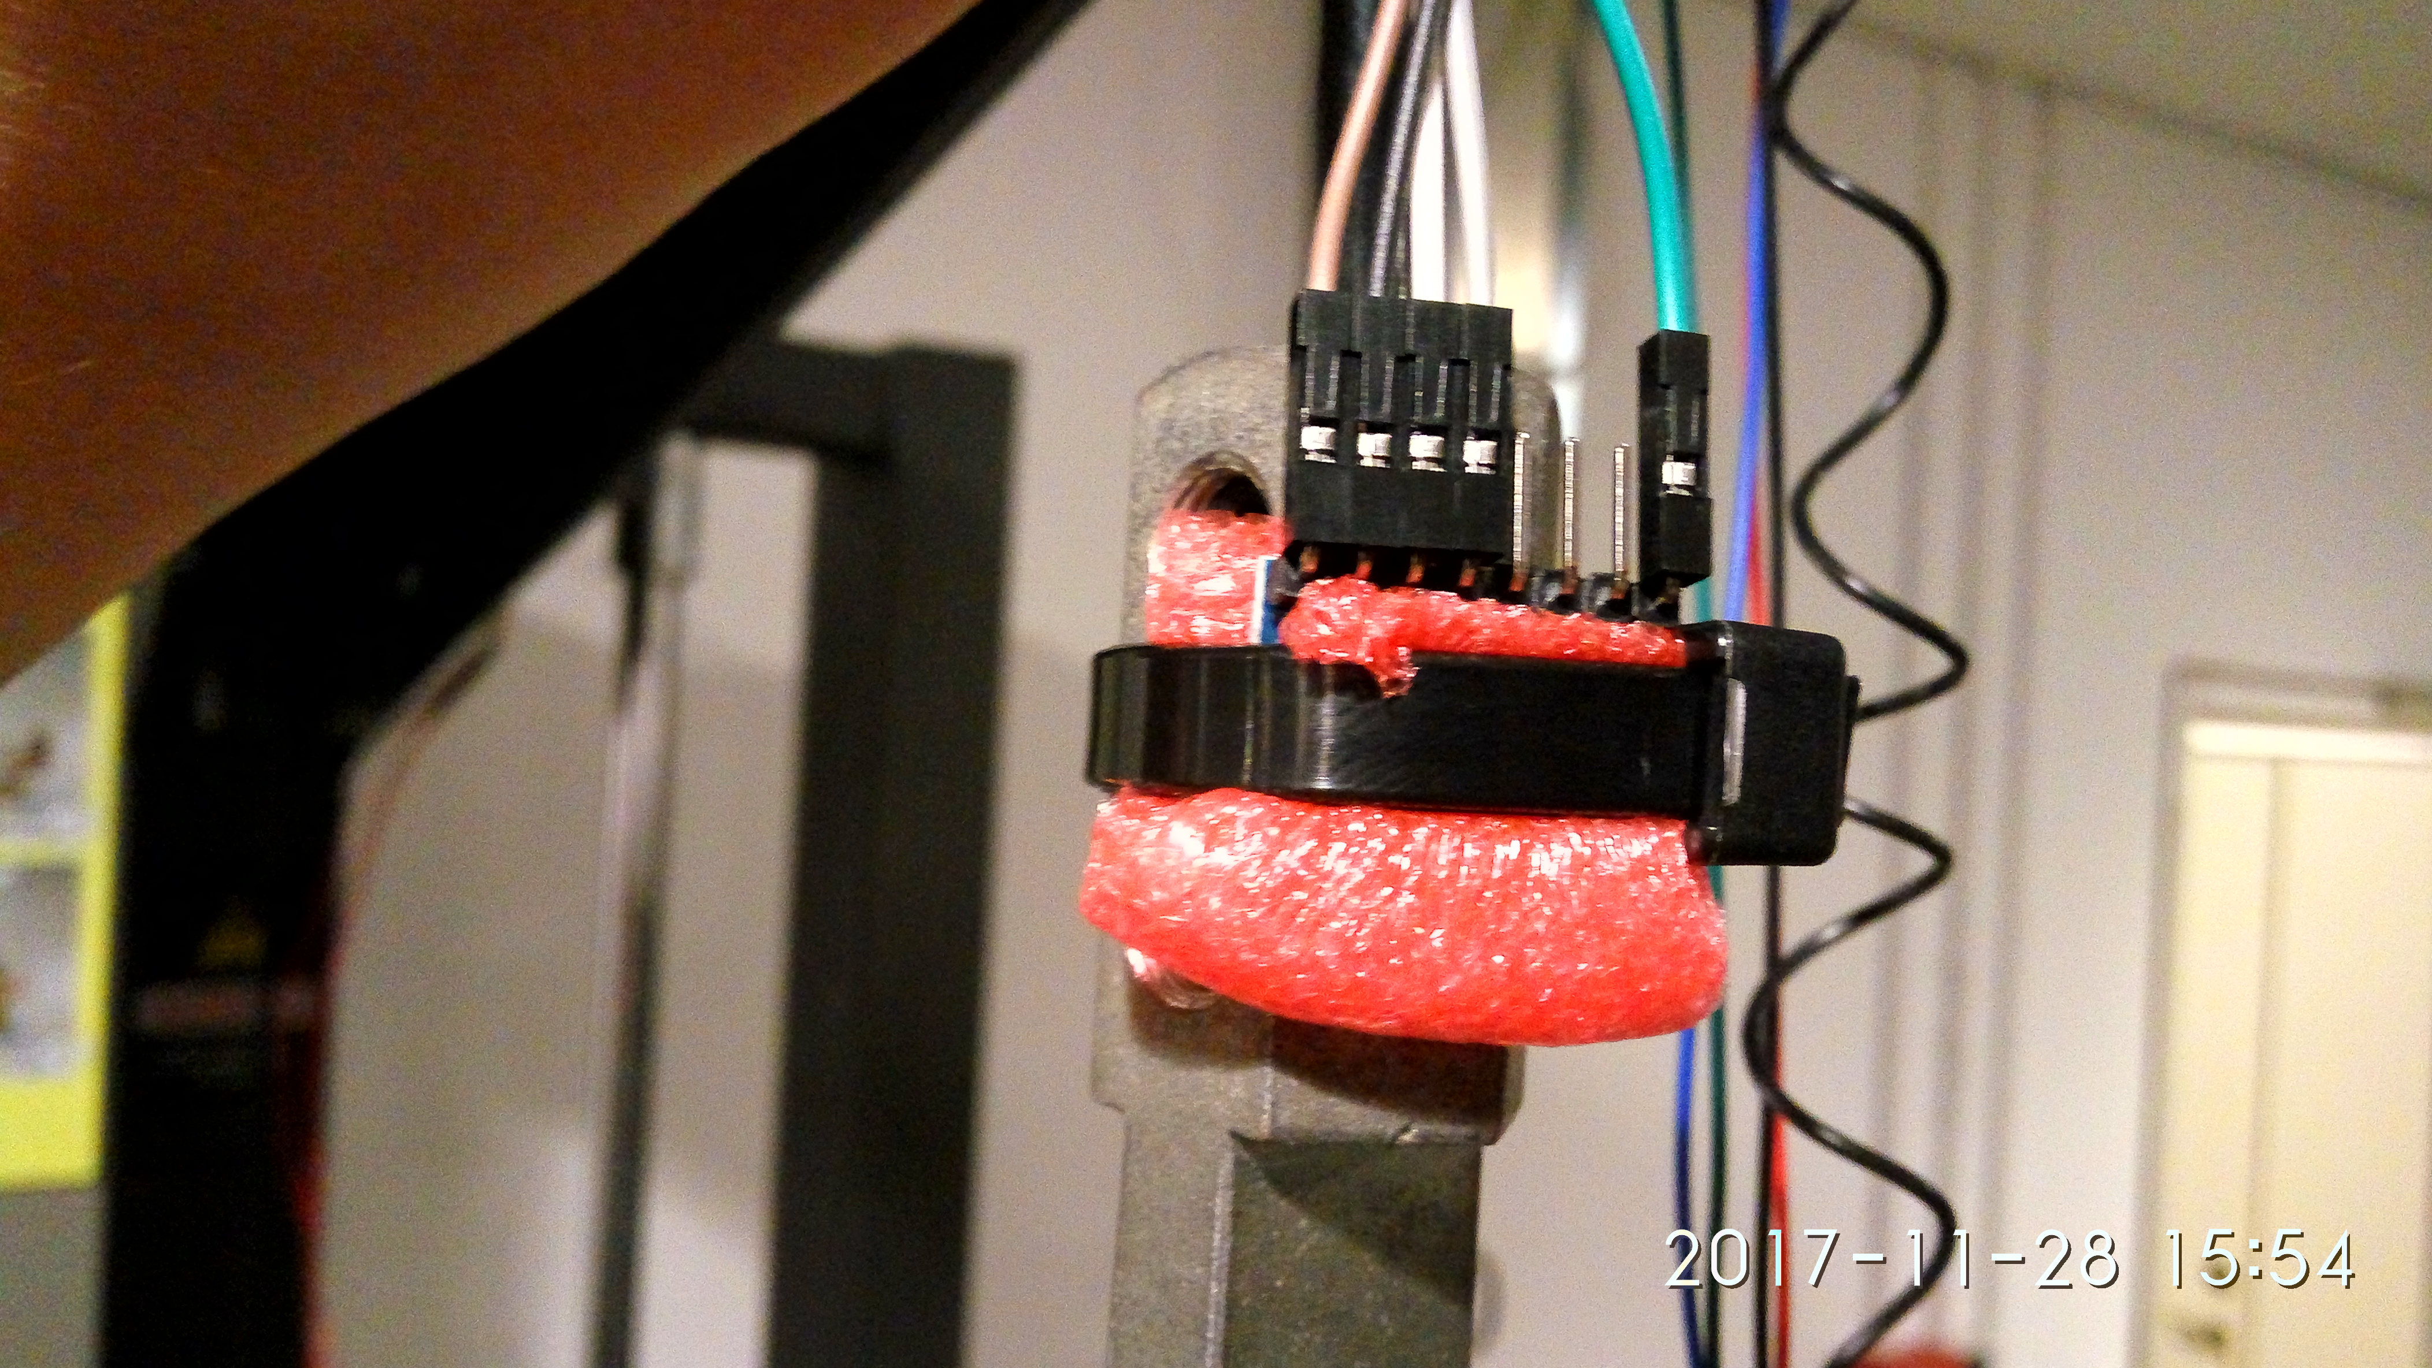
The Setup (2/5): 6 Degree of Freedom

Slide 6
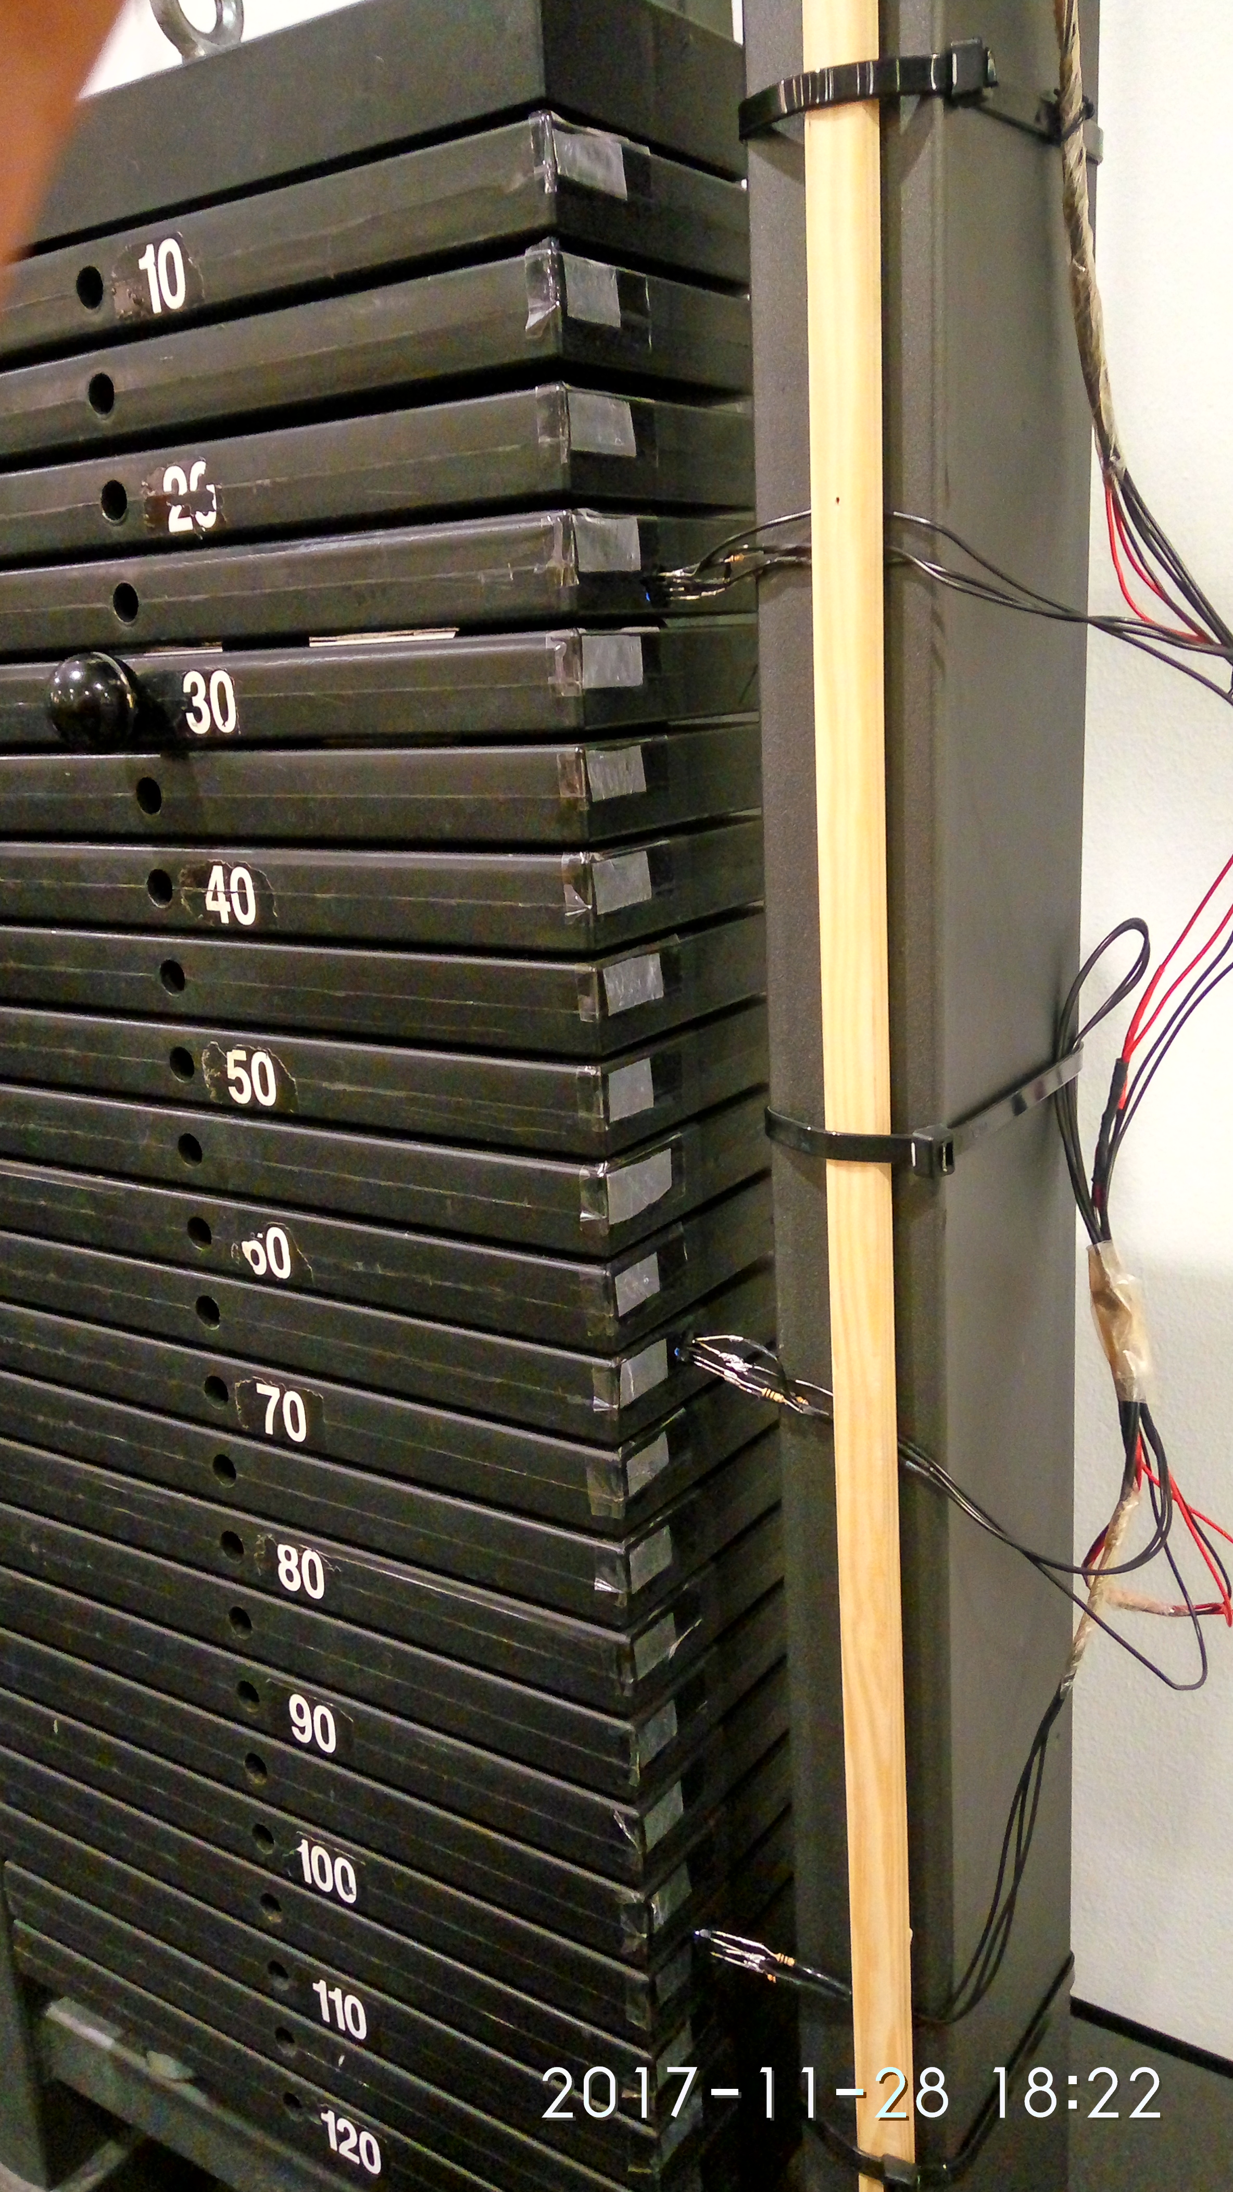
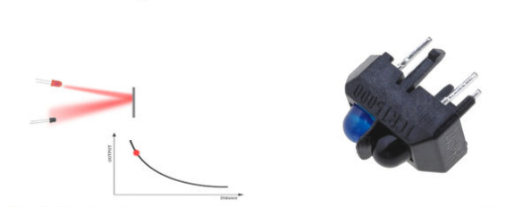
The Setup (3/5): IR Sensor (TCRT 5000)

Slide 7
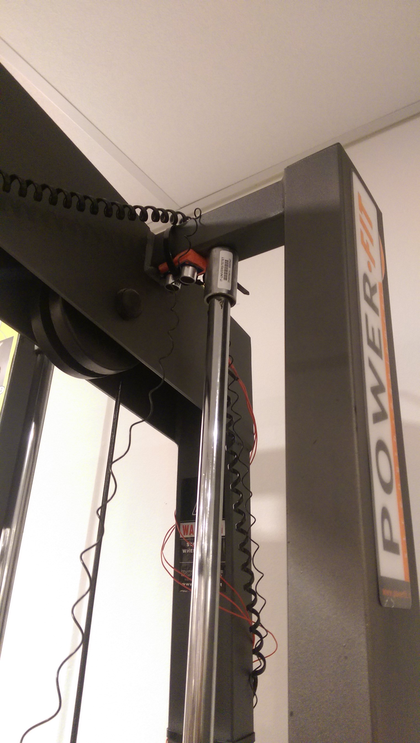
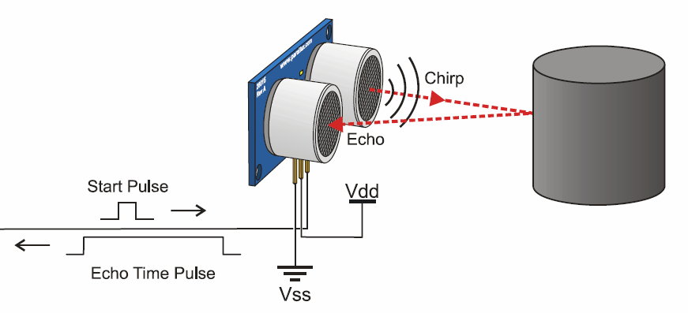
The Setup (4/5): PING))) Ultrasonic Distance Sensor

Slide 8
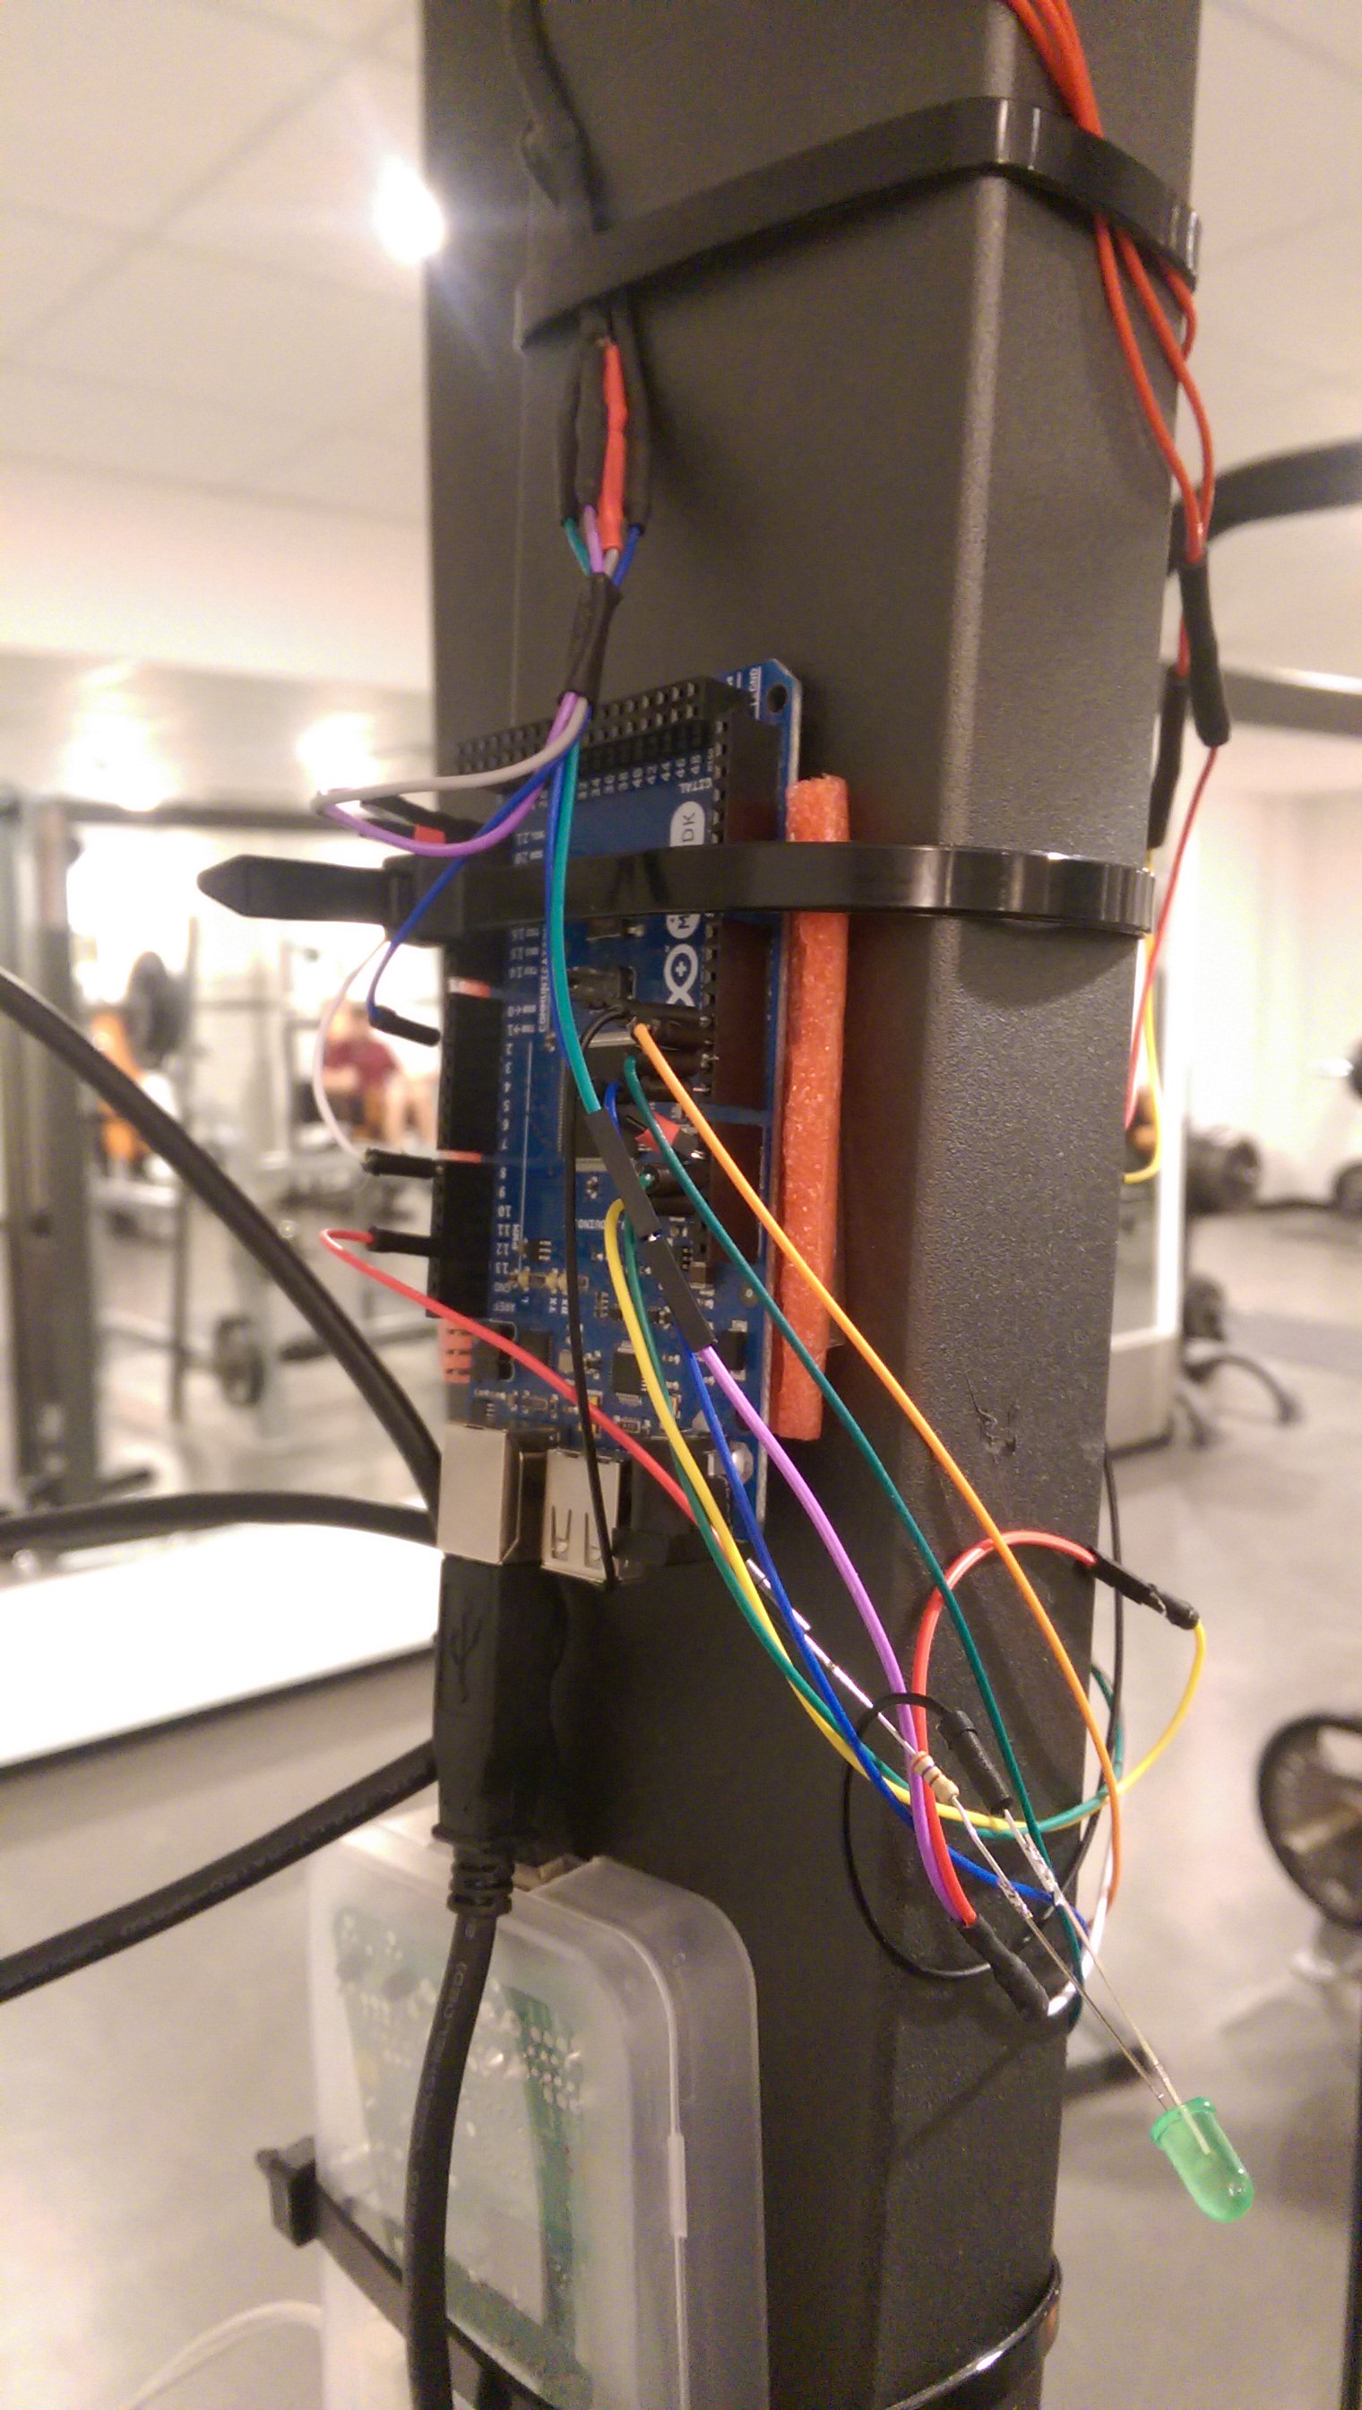
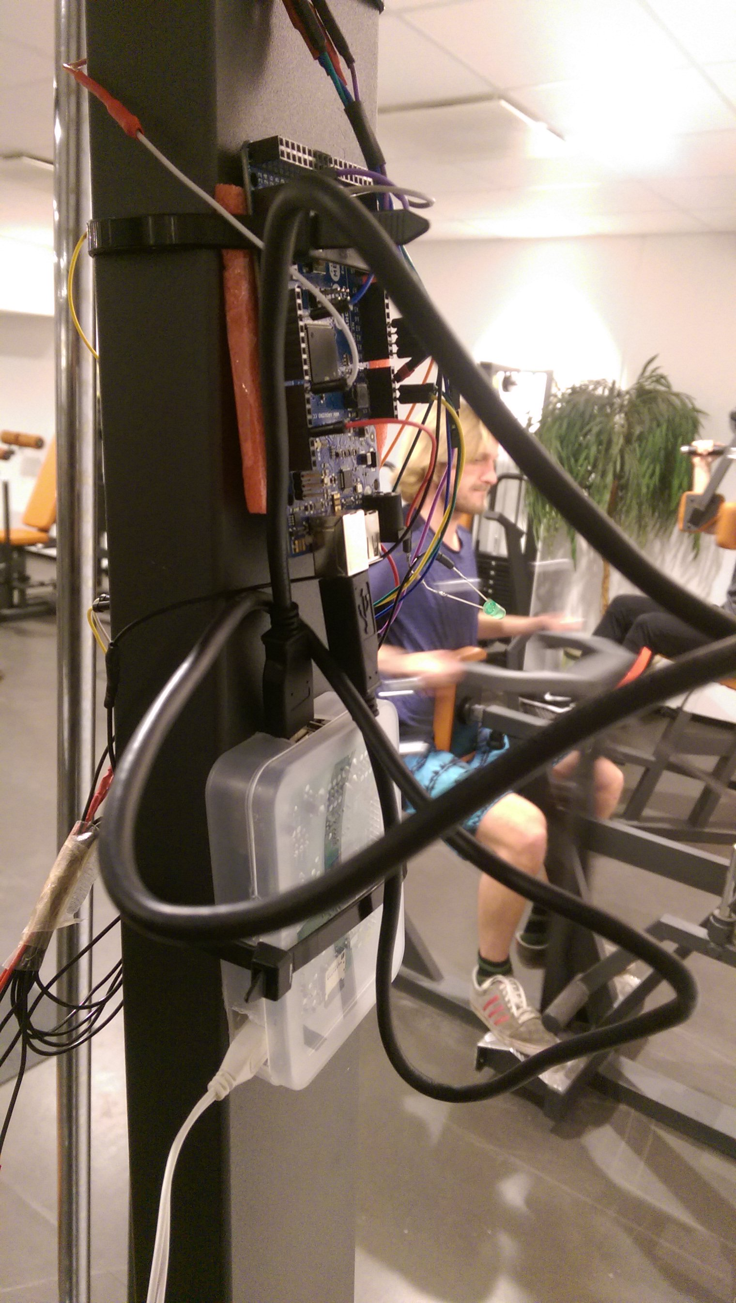
The Setup (5/5)

Slide 9
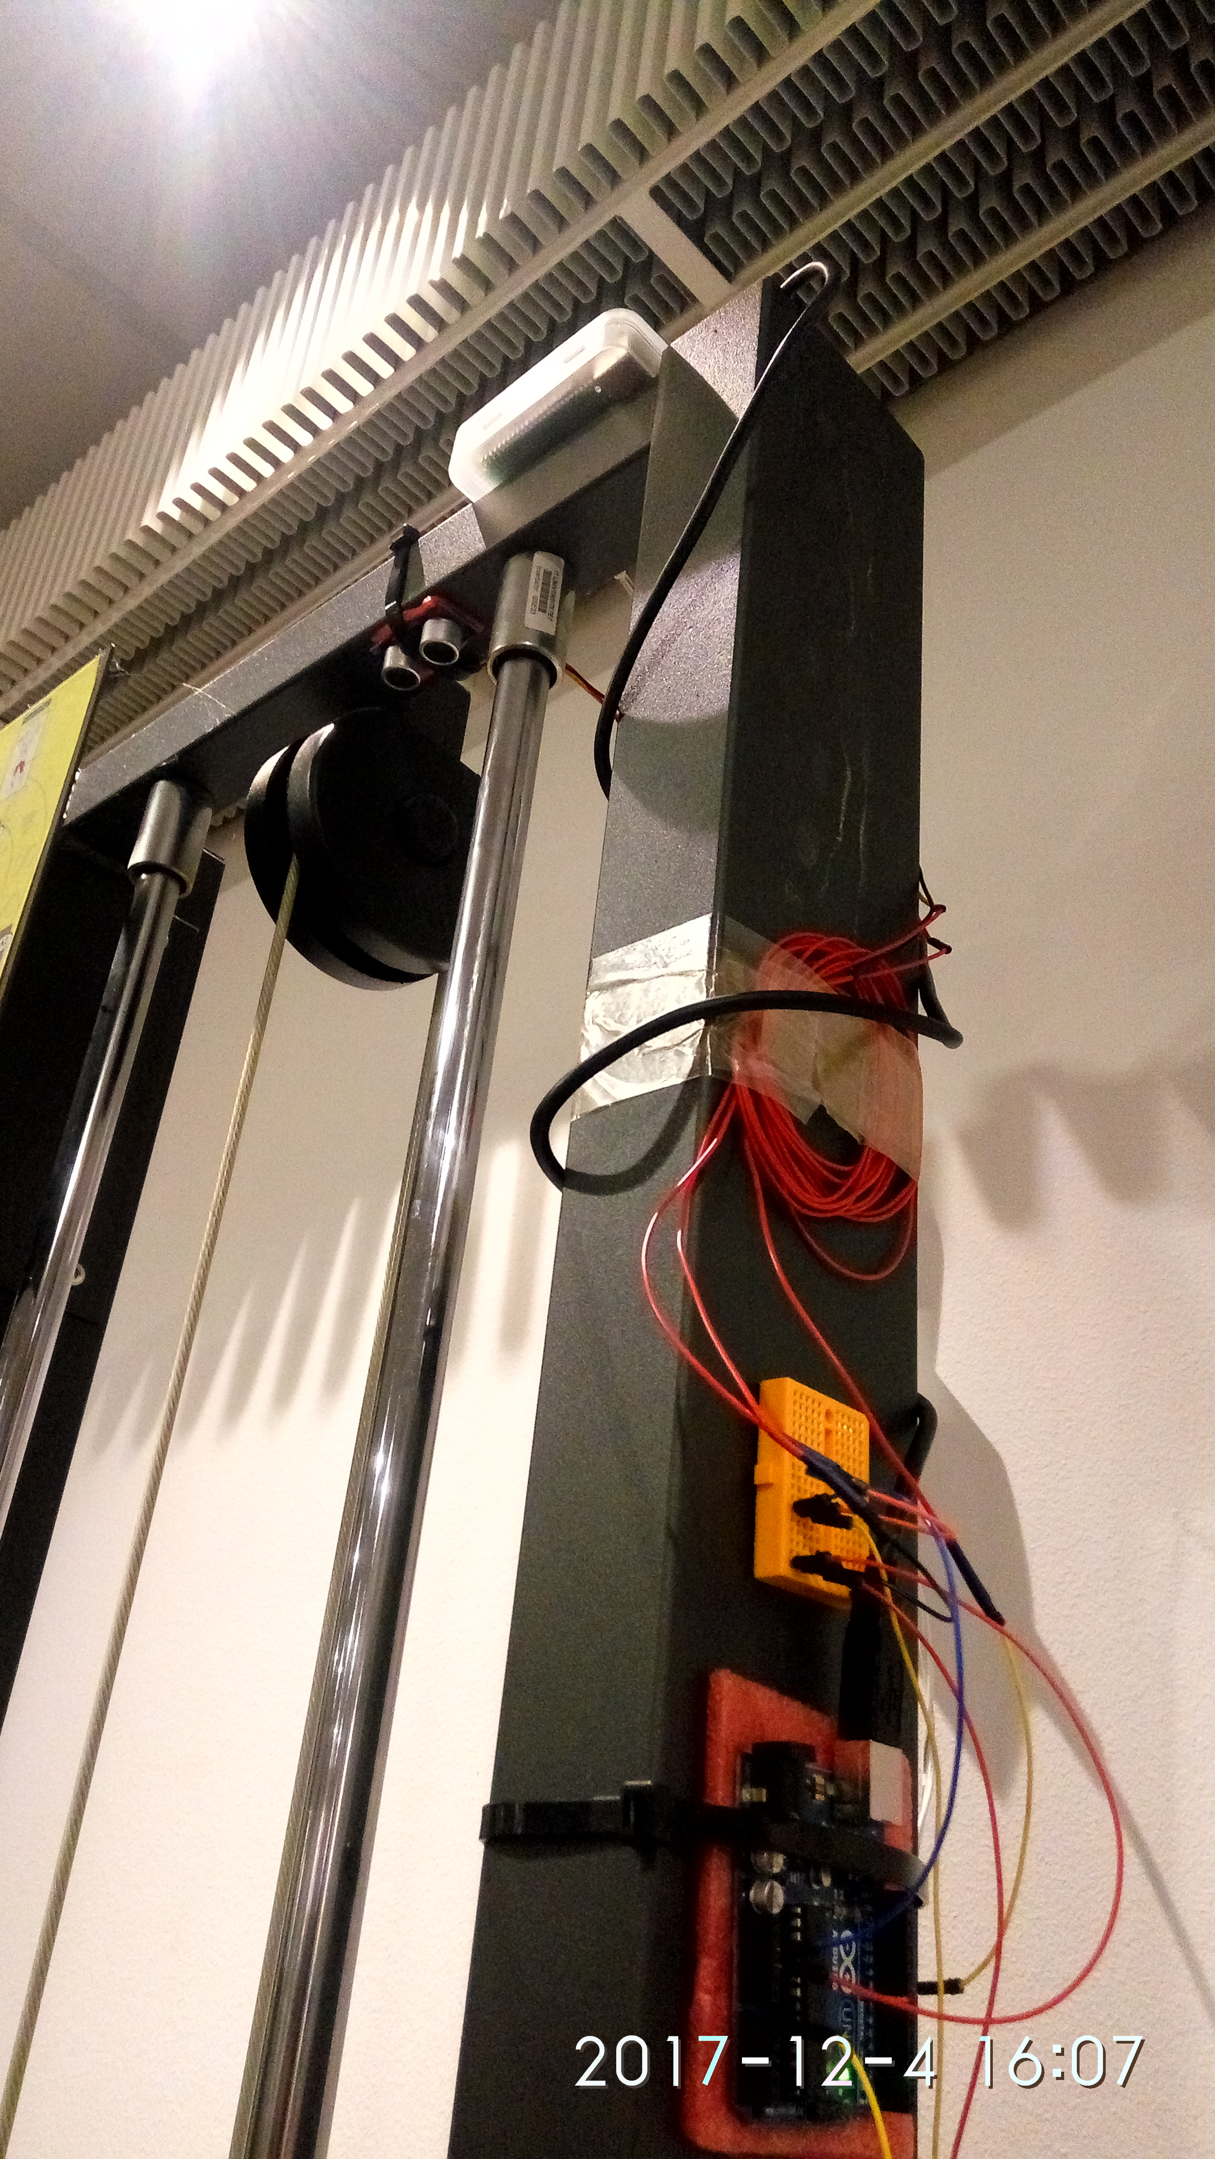
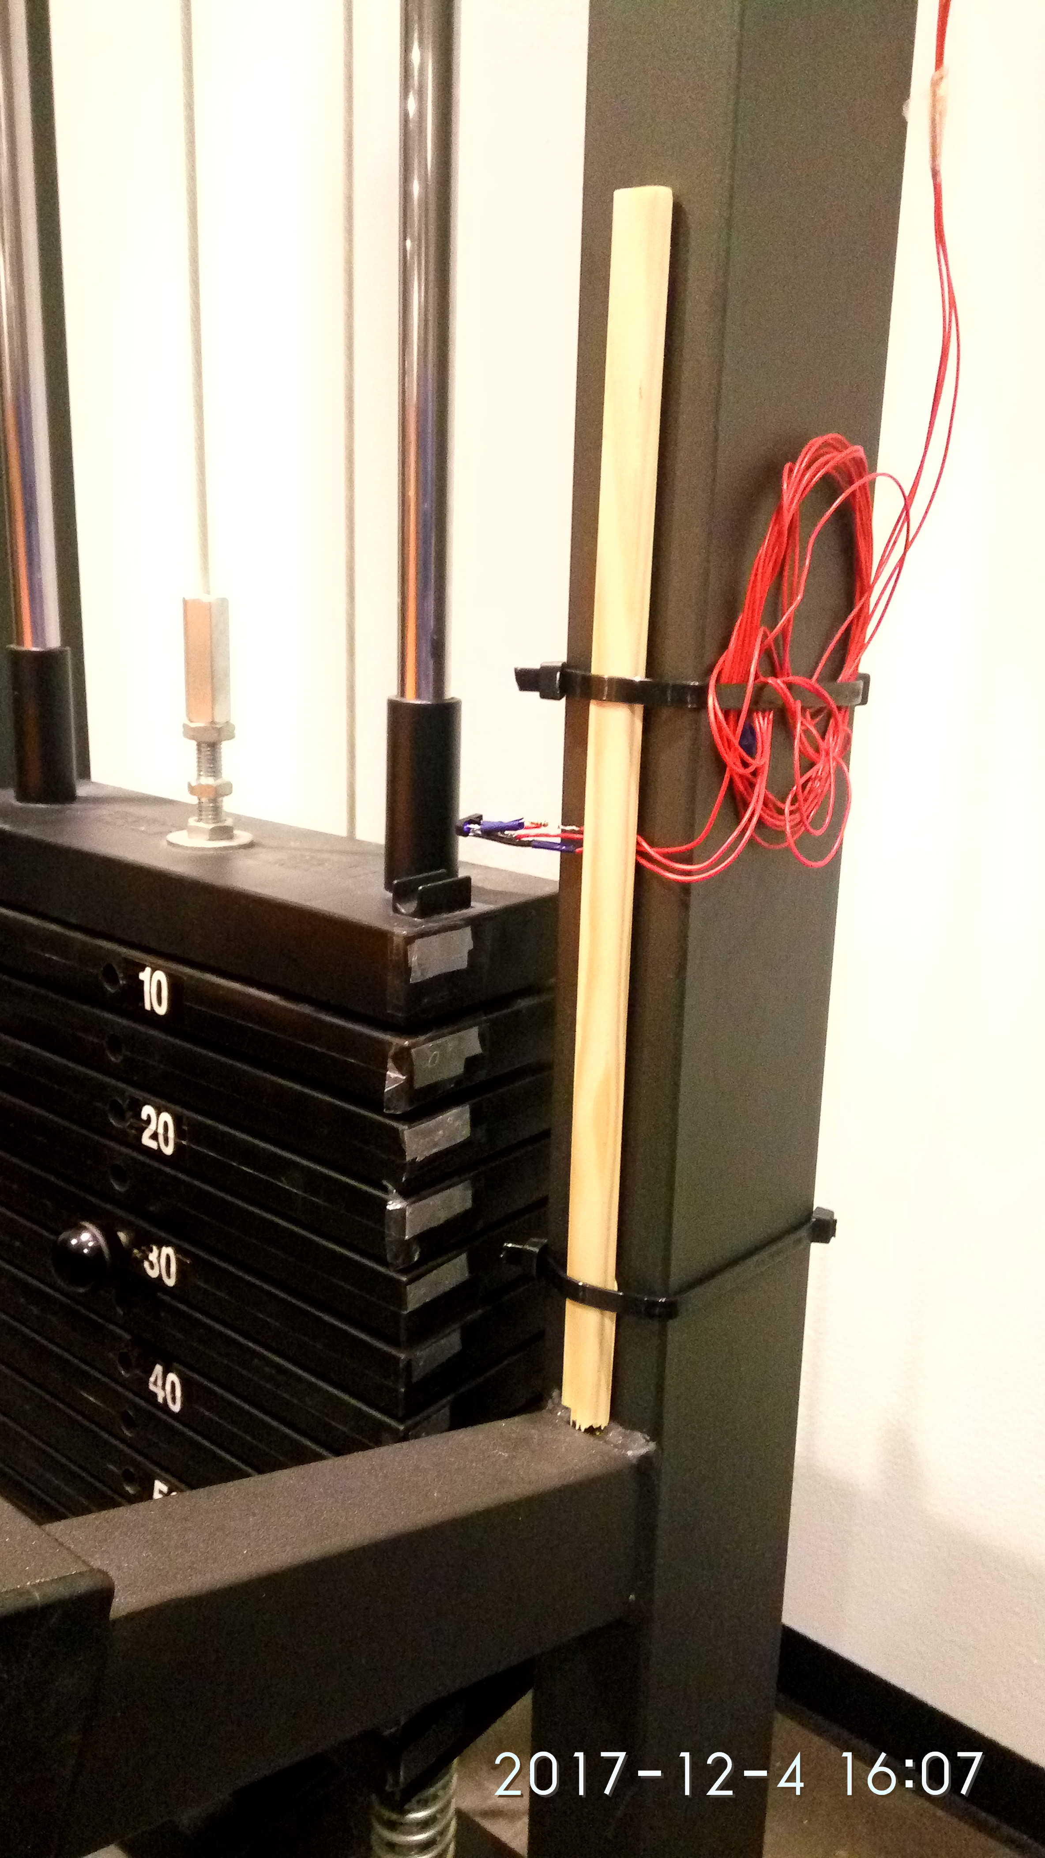
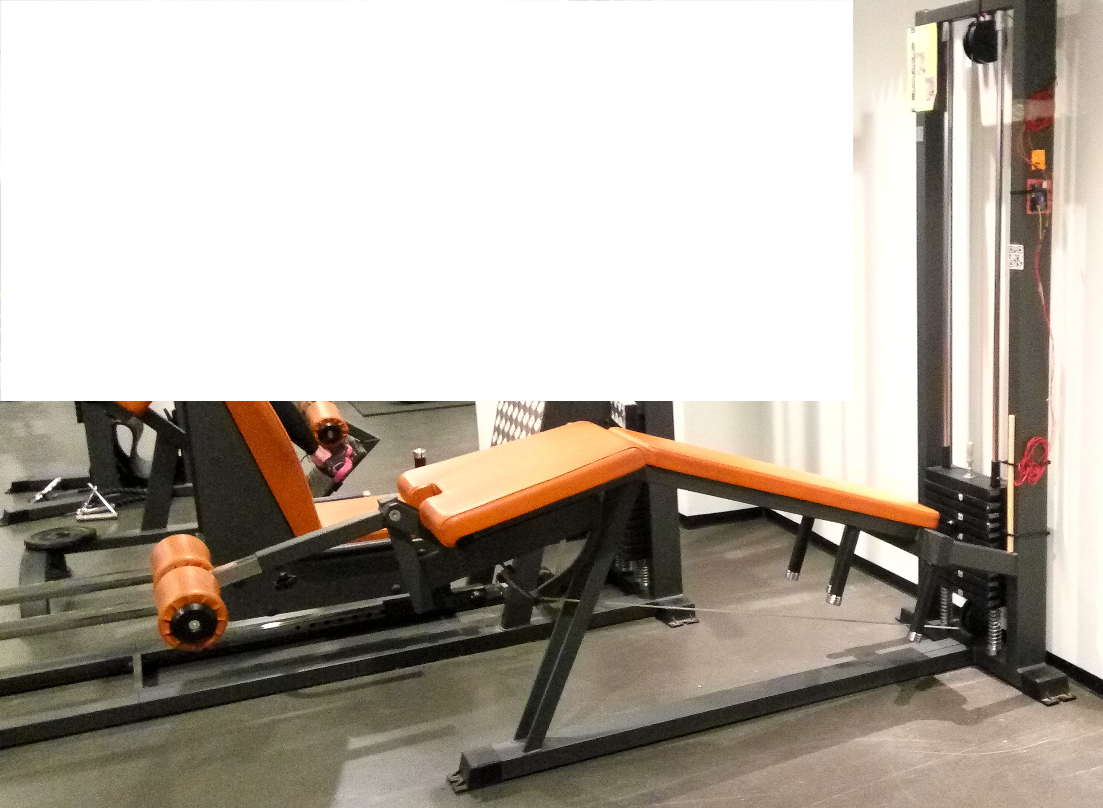
Leg Machine Setup ( No 6 DOF)

Slide 10
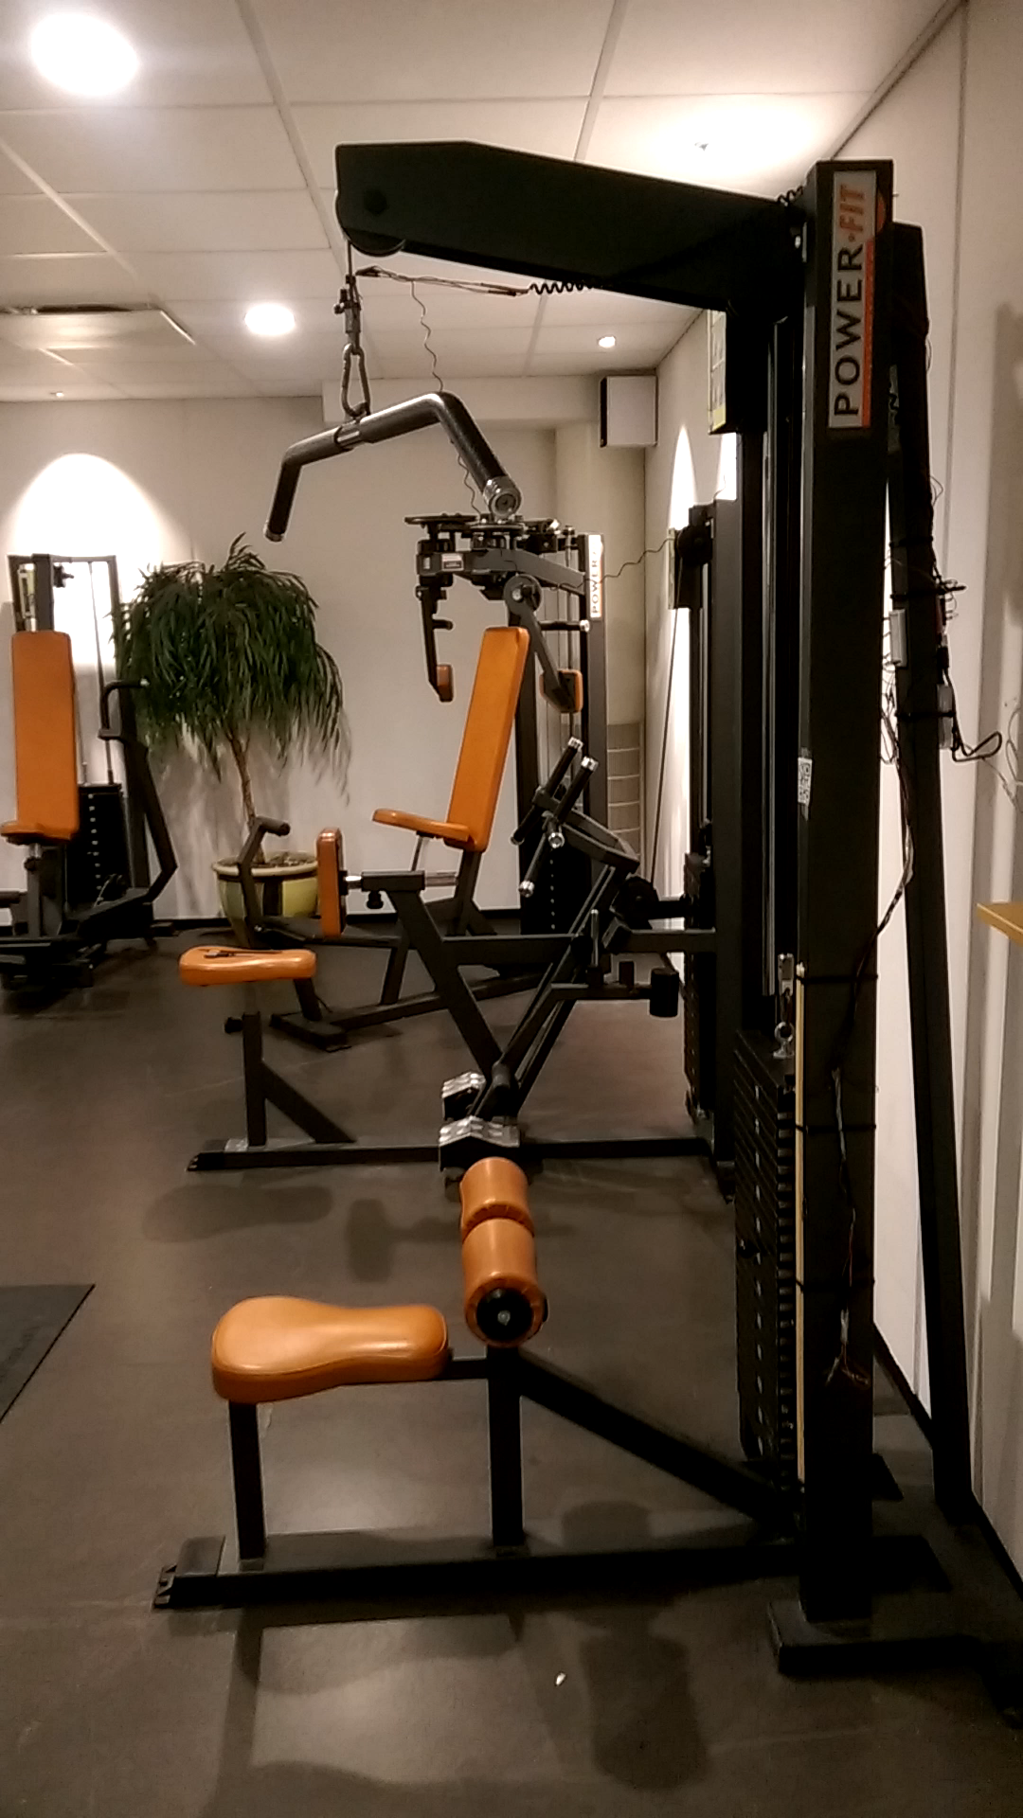

Slide 11
Results

Slide 12
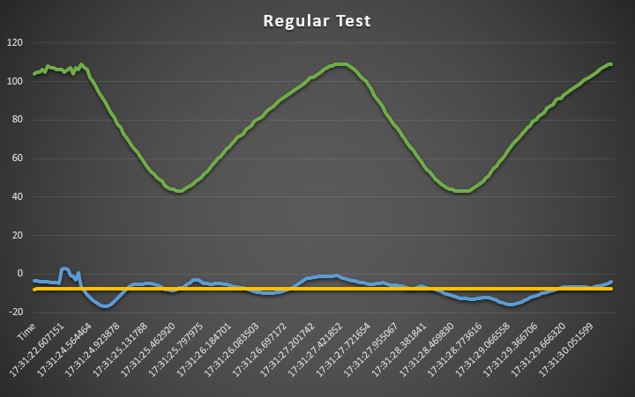
Real: reps = 2, weight = 30kg
Algorithm: reps = 2, weight = 30kg

Slide 13
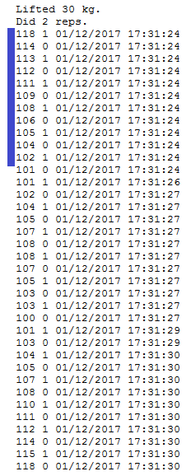
Weight data
Data format:
First - height in centimeters
Second - Tinfoil on weight disk (1=yes,0=no)
Third- Date and time
We can get the amount of lifted weight by counting tinfoil until the height starts increasing (blue bar). Each disk weighs 5 kilogram.
In this example we see tinfoil passing by 6 times → 6*5kg = 30kg.

Slide 14
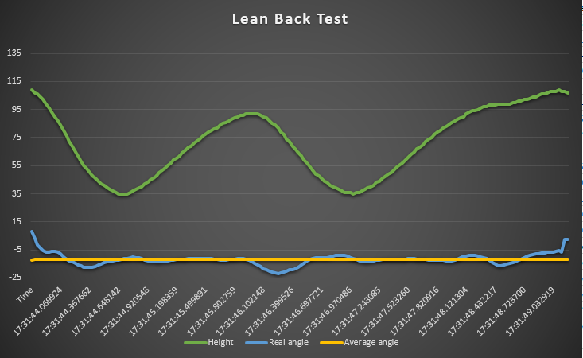
Real: reps = 2, weight = 30kg
Algorithm: reps = 2, weight = 30kg

Slide 15
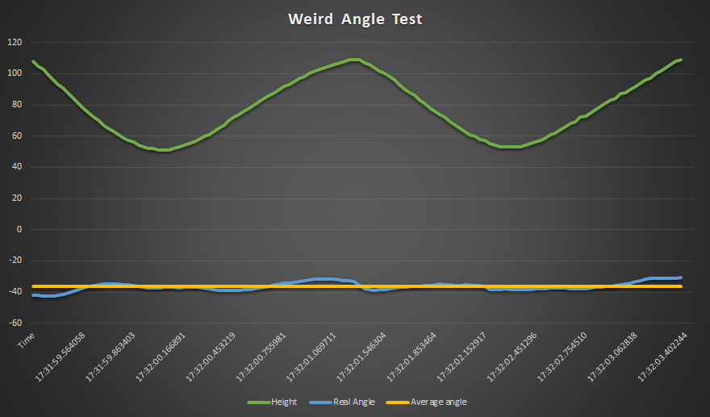
Real: reps = 2, weight = 30kg
Algorithm: reps = 2, weight = 15kg

Slide 16
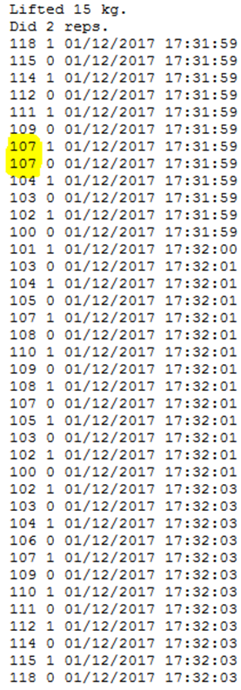
Error in parsing
The height sensor is not 100% accurate
Algorithm needs to allow for a few values that don’t fit
Sometimes the user might not pull right away after sitting down, giving lots of conflicting values

Slide 17
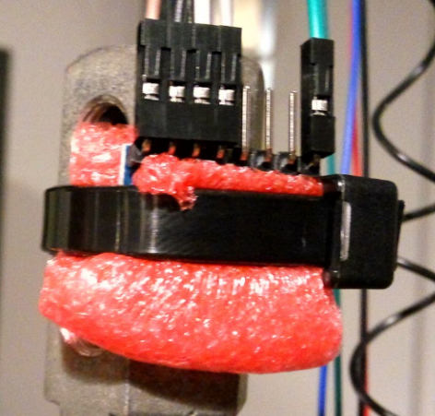
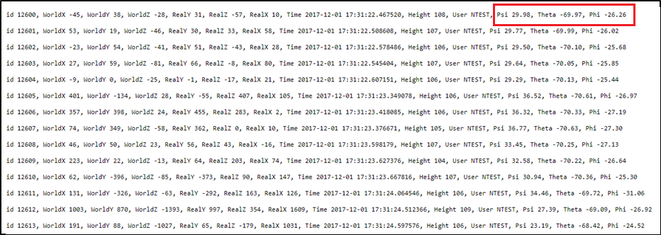
6 Degree of Freedom data

Slide 18
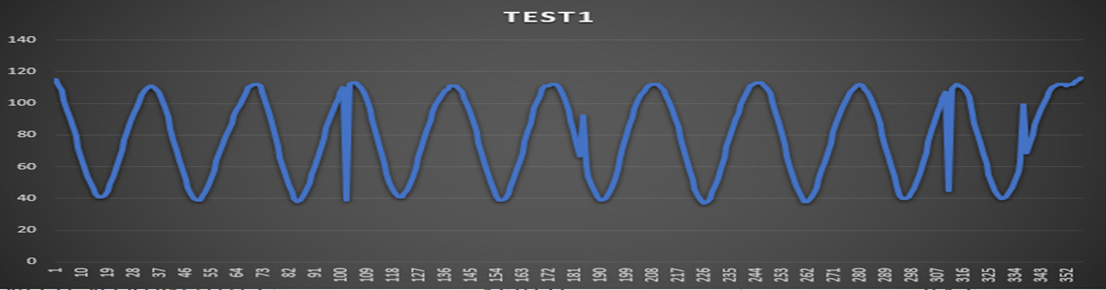
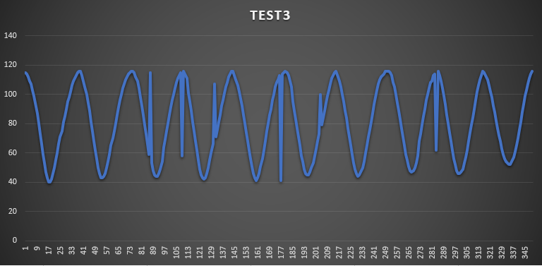
Real: reps = 10, weight = 30kg
Algorithm: reps = 10, weight = 30kg
Real: reps = 10, weight = 60kg
Algorithm: reps = 10, weight = 60kg

Slide 19
Thank you

